Slide 1
Light sensor time management
環境4年 71748760 Masashi Wakita

Slide 2
Ultrasonic sensor and some LEDs

Slide 3
Image

Slide 4
Plan
Arduino can decide when leds light by the distance between wall and that sensor. For example, if the distances are 5cm and 10 cm and 15 cm and 20cm , therefore leds light in 5min and 10 min and 15min and 20 min.
Light’s pace of leds speed up if my task is emergency. That can decide by number of times pushed button at first.

Slide 5
https://www.youtube.com/watch?v=9yBO43W17SM

Slide 6
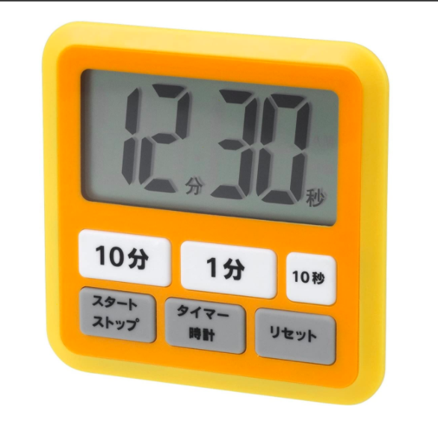
outcome
We can treat quantitative time as intuitive time. We can add time by distance between the wall and the timer if I couldn’t make time it in time.
This prototype timer can use as kitchen timer if it is applied.

